Slide 1

Impacts of Social Media Habits
A Big Data Mining Project by:
Nathan Hittesdorf
Megha Nayar
Jash Shah
Svetlana Voda
Sebastian Barroso
Notes:
jash

Slide 2
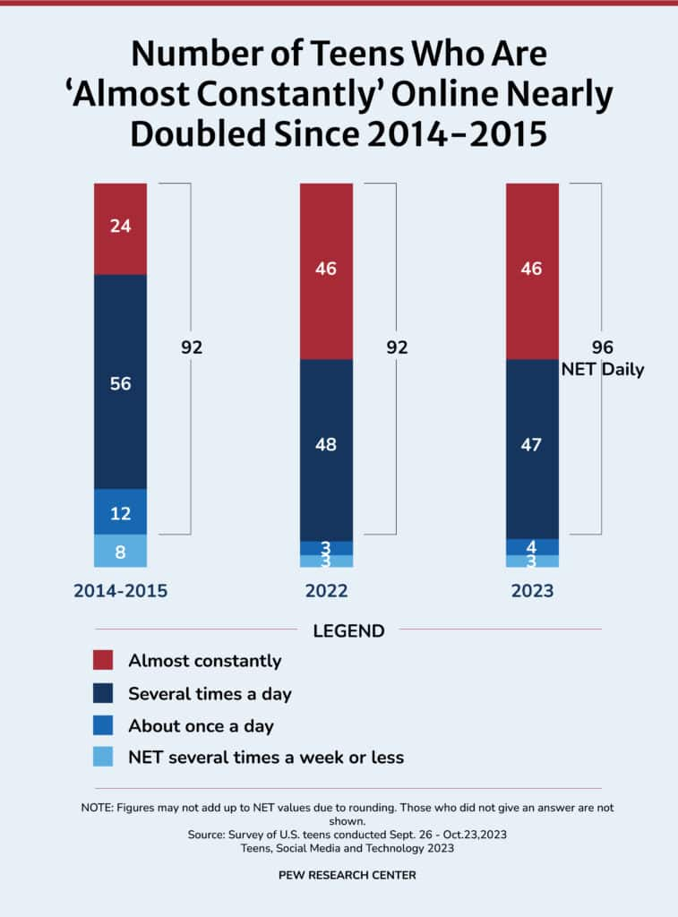
Impacts of Social Media Habits
Problem: Social media addiction is a growing problem, affecting mental health and productivity. Current efforts lack data-driven insights to address this issue effectively.
Solution: We use Big Data mining techniques to find data & patterns to reduce social media addiction.
Notes:
Jash

Slide 3
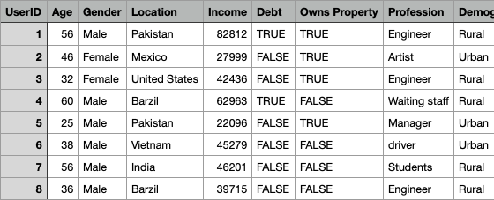
The Data
Data Overview
Our dataset captures key user demographics, platform engagement, and behavioral patterns:
User Info
Platform Activity
Device & Connection
User Impact Metrics:
Productivity Loss
Satisfaction & Addiction Level
An example subset of the data.
Notes:
Murf Our dataset consist of demographics such as age sex and other accessible heart features like blood pressure and cholesterol, and etc, which made it very easy to work with and gave an output of 0 for no heart attack and 1 for heart attack

Slide 4
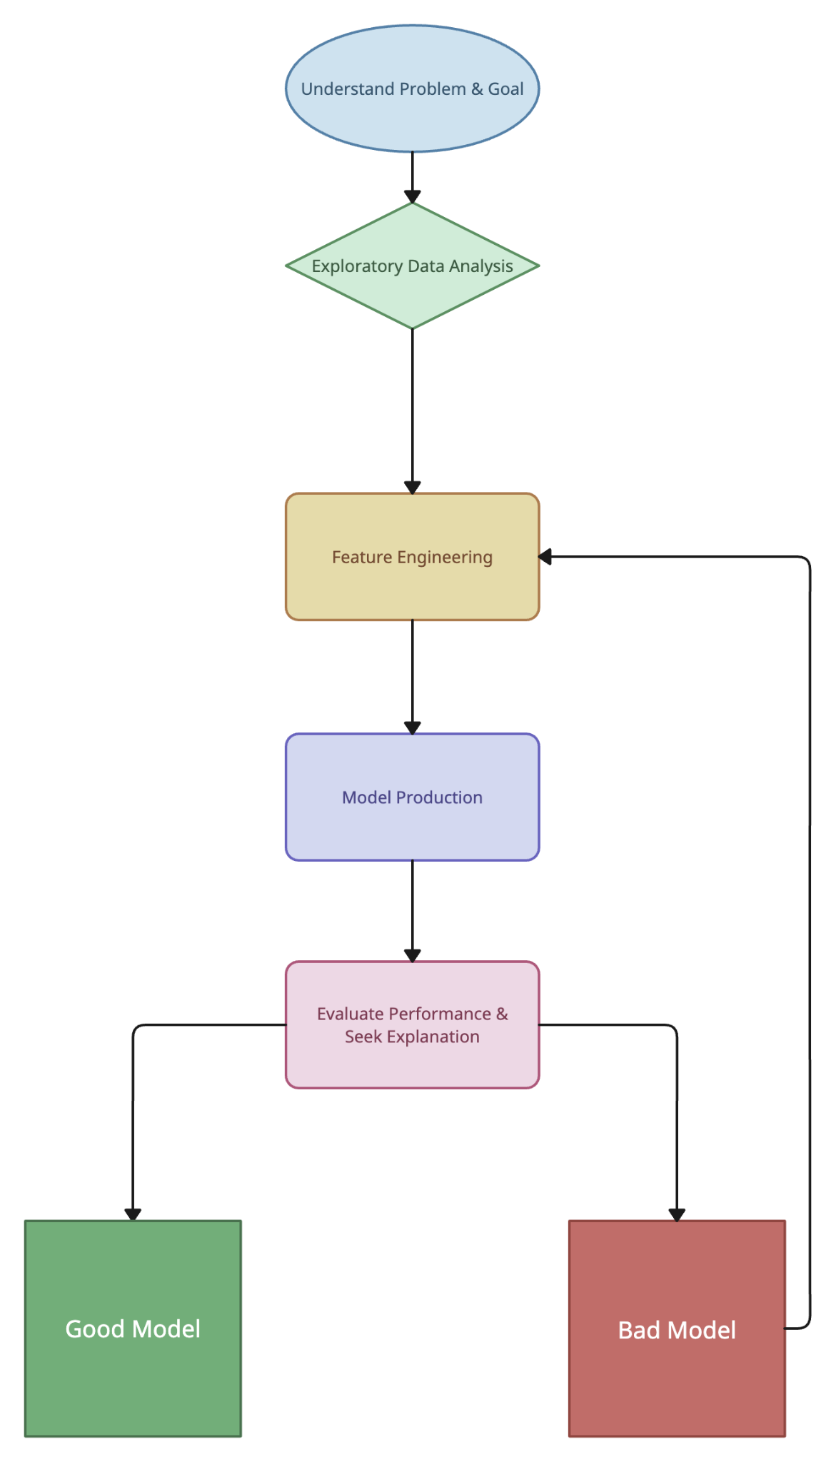
Our Approach
Utilize Initial EDA to understand our dataset
Utilize different big-data mining approaches to:
Classify users into categories that can be used to identify at-risk users.
Predict user’s addiction status directly from the data.
Identify trends and patterns that contribute to addiction for future predictive efforts.
Notes:
Svetlana : We start by conducting Initial EDA to understand our dataset. Then, we apply big-data mining techniques such clustering, recommendation, linear and rigid regression, graph network analysis to classify users into risk categories, predict addiction levels directly from the data, and identify trends and patterns contributing to addiction for future predictions and interventions.

Slide 5
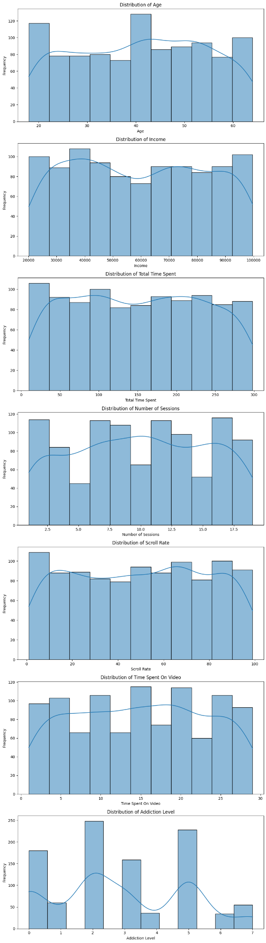
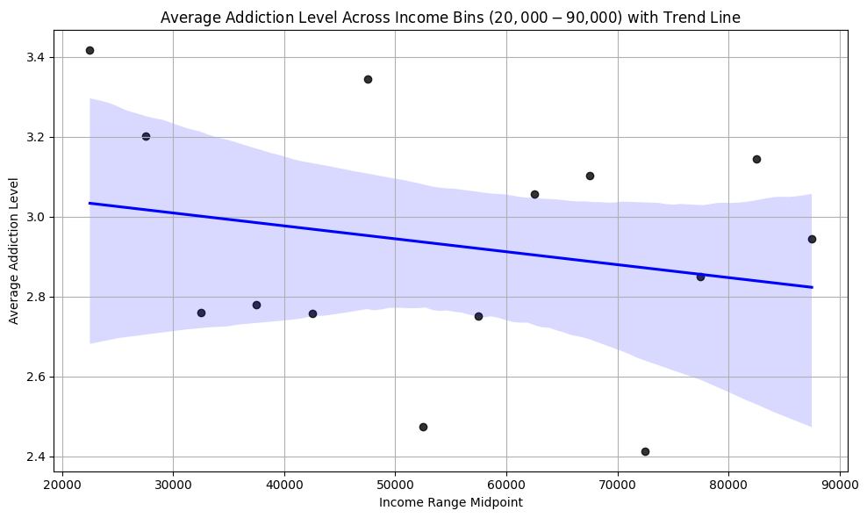
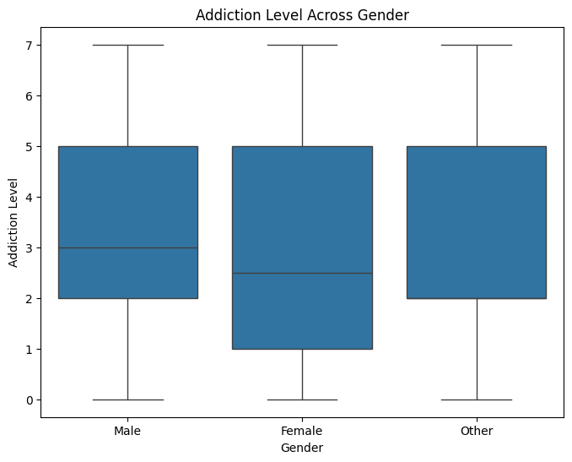
Exploratory Data Analysis: Summary Statistics
Notes:
Nathan

Slide 6
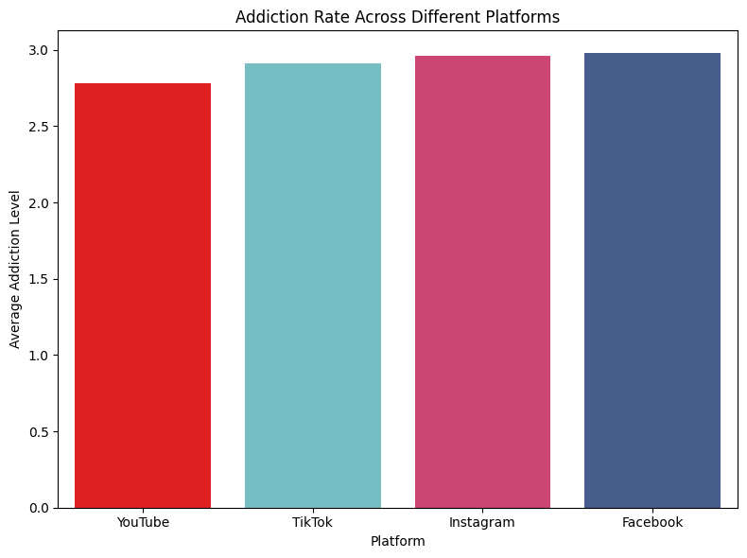
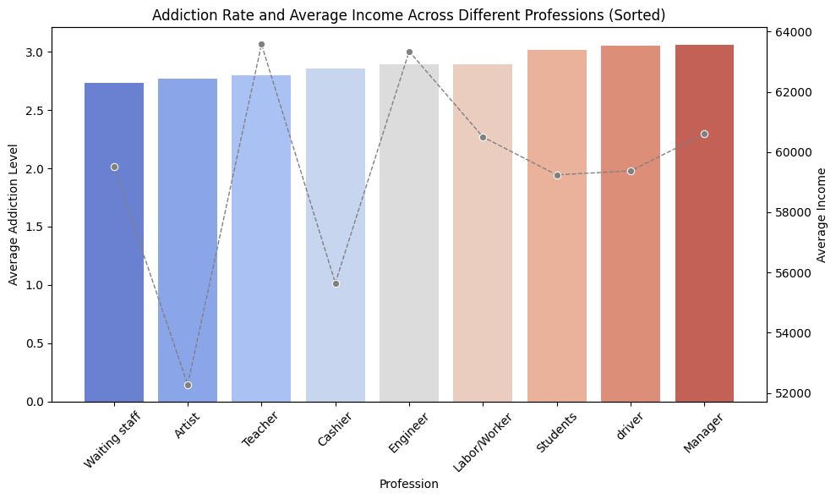
Exploratory Data Analysis: Deeper Trends Pt. 1
Notes:
Nathan

Slide 7
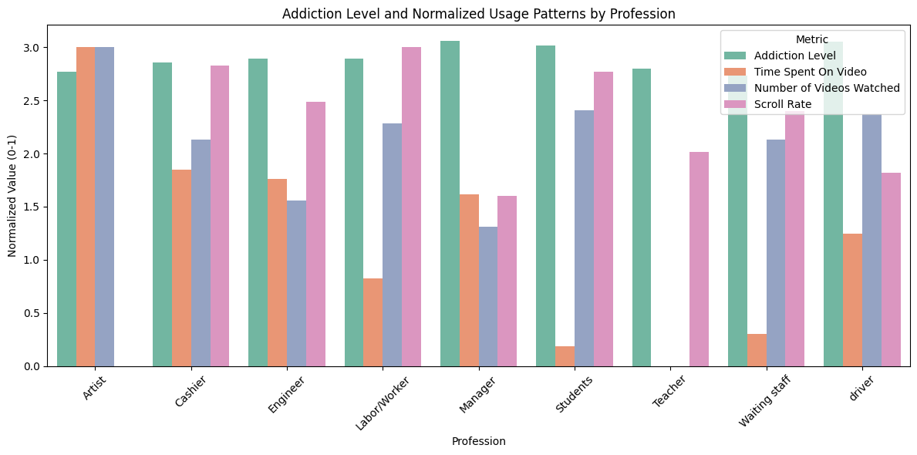
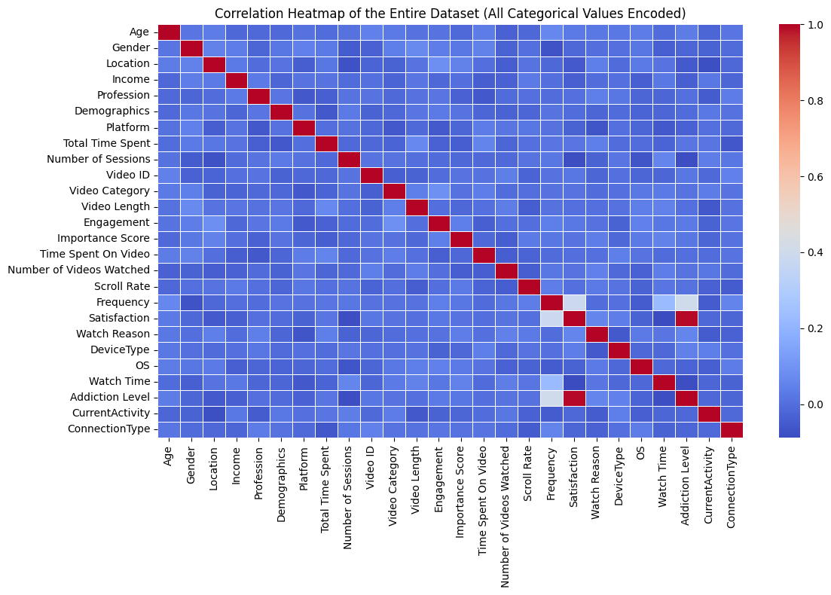
Exploratory Data Analysis: Deeper Trends Pt. 2
Notes:
Nathan

Slide 8
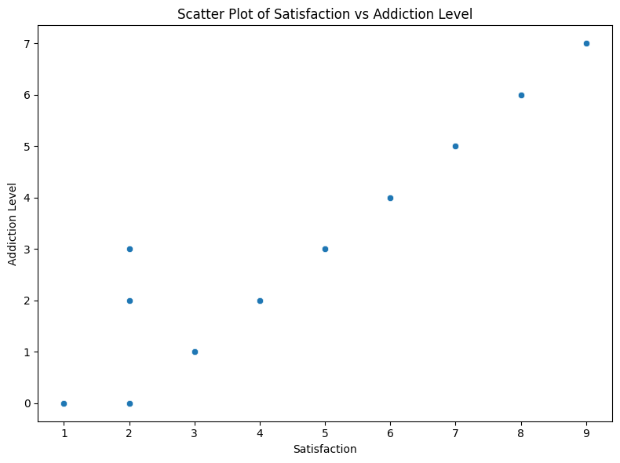
Exploratory Data Analysis: Findings
Initial Hypothesis: Income is the strongest predictor of addiction level.
Key Insights:
Weak Correlations: Relationships were observed to be limited in strength across the board between addiction level and demographic factors like income, gender, or profession.
Gender & Profession: Addiction levels were consistent across genders and professions.
Platform Analysis: Facebook emerged as the most addictive platform, though the margin was small.
Satisfaction vs. Addiction: A nearly perfect linear correlation was observed between satisfaction and addiction levels. However, this was later identified as an artifact of synthetic data, warranting its exclusion from predictive models.
Distribution of Addiction Levels: The data for addiction levels deviated significantly from a normal distribution.
Notes:
Nathan

Slide 9
Analysis 1: Clustering
Goal: Utilize clustering techniques to identify and classify individuals based on their addiction risk factors.
Approaches:
Dimensionality Reduction (PCA): Simplify data using PCA, create representative risk clusters, and use cosine similarity to match users with these clusters.
Agglomerative Clustering: Group users by addiction levels, profile clusters, and identify at-risk individuals using frequent attribute patterns.
LSH Minhashing: Apply Locality-Sensitive Hashing to efficiently find user similarities and develop a pipeline for predicting addiction risk profiles.
Notes:
Nathan

Slide 10
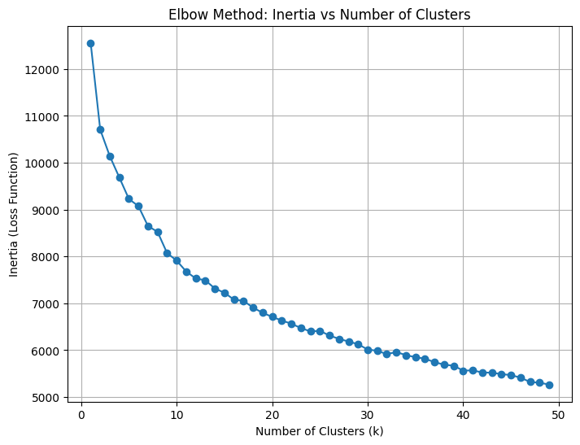
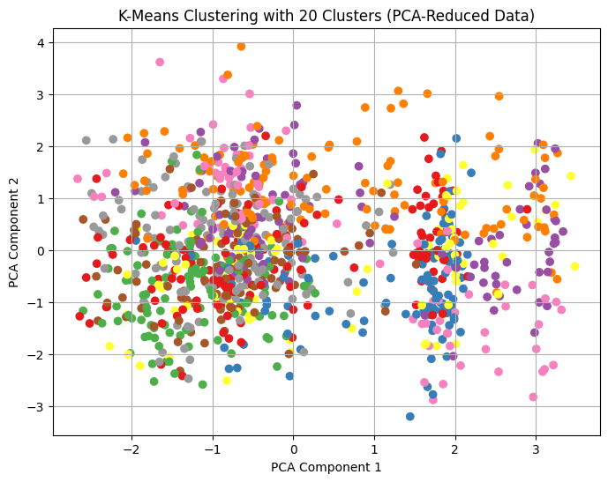
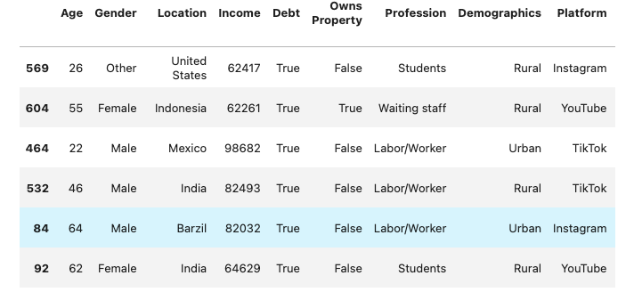
Clustering: K-Means & PCA
Goal: Simplify data to focus on key features while preserving patterns for clustering.
Concept: Principal Component Analysis (PCA) reduces high-dimensional data into a smaller number of uncorrelated components by maximizing variance. This ensures the most meaningful patterns are retained, improving cluster separation.
Approach:
Use PCA to transform features into principal components.
Tune hyperparameters (e.g., number of components & cluster count) to balance dimensionality reduction and data retention.
Perform clustering (e.g., k-means) on the reduced dimensions to identify representative clusters.
Outcome: Generated cluster centroids for addiction risk profiles and used cosine similarity to match real-world users with cluster centroids, enabling personalized risk assessment. These real world users are representative of specific demographic groups and can be used for further addiction analysis and prevention.
Notes:
Nathan

Slide 11
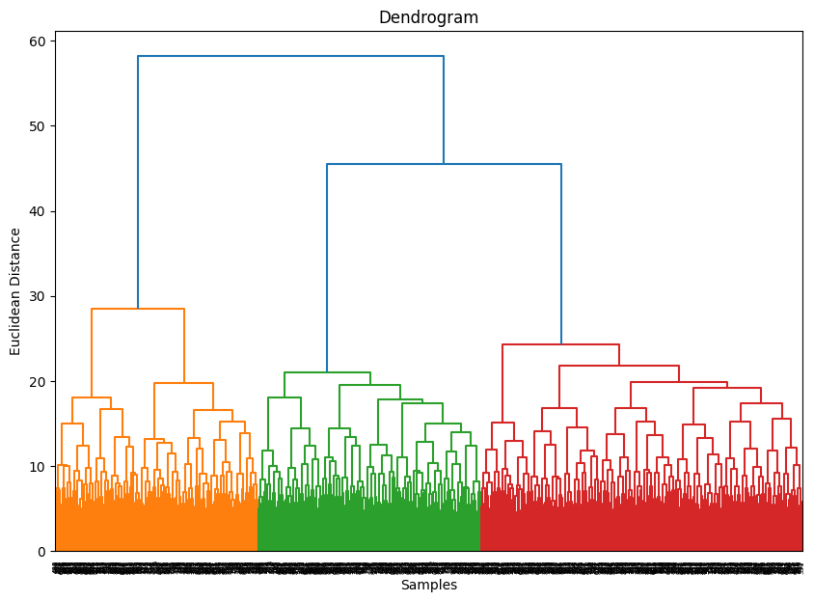
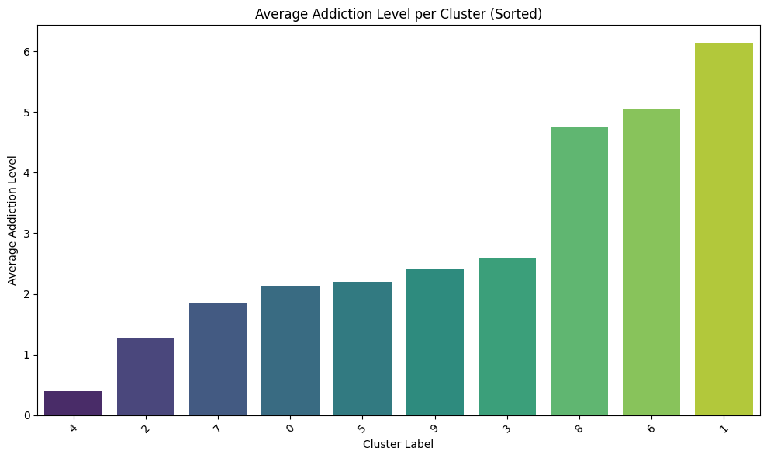
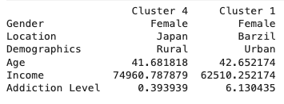
Clustering: Agglomerative
Goal: Group users based on their addiction levels and demographics to profile risk.
Concept: Hierarchical clustering iteratively merges or splits clusters based on similarity metrics (e.g., Euclidean distance), forming a dendrogram that reveals data structure.
Approach:
Compute similarity between users based on addiction and related features. Hyperparameter tune to optimize for silhouette score.
Use average linkage (mean of all pairwise distances) to merge clusters with similar addiction levels.
Profile clusters by calculating weighted mode of key features, identifying the most at-risk demographic groups.
Outcome: Defined cluster profiles and pinpointed users most vulnerable to addiction by analyzing frequent patterns within each cluster.
Notes:
Nathan

Slide 12
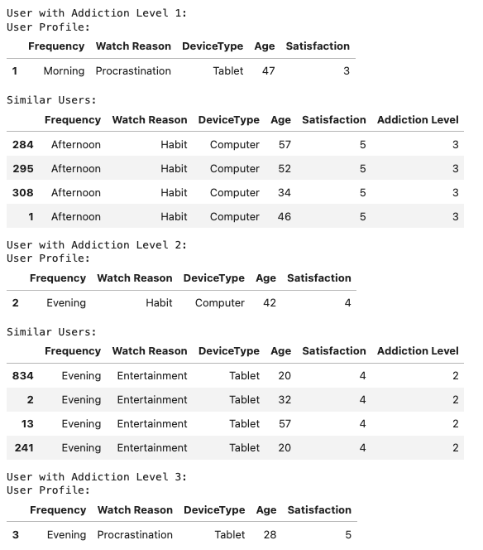
Clustering: LSH Minhashing
Goal: Efficiently identify users with similar behavioral patterns to predict addiction risk.
Concept: Locality-Sensitive Hashing (LSH) approximates similarity between high-dimensional objects. Minhashing uses hash functions to create signatures that preserve similarity in data (e.g., Jaccard similarity).
Approach:
Convert user data into hashed signatures using Minhash functions.
Compare these signatures to group users with similar behaviors.
Apply results in a prediction pipeline to classify addiction profiles based on frequent user similarities.
Outcome: Built a scalable method to identify behavioral patterns and cluster similar users in real-time. Identify correlated behaviors between users of all addiction levels.
Notes:
Nathan

Slide 13
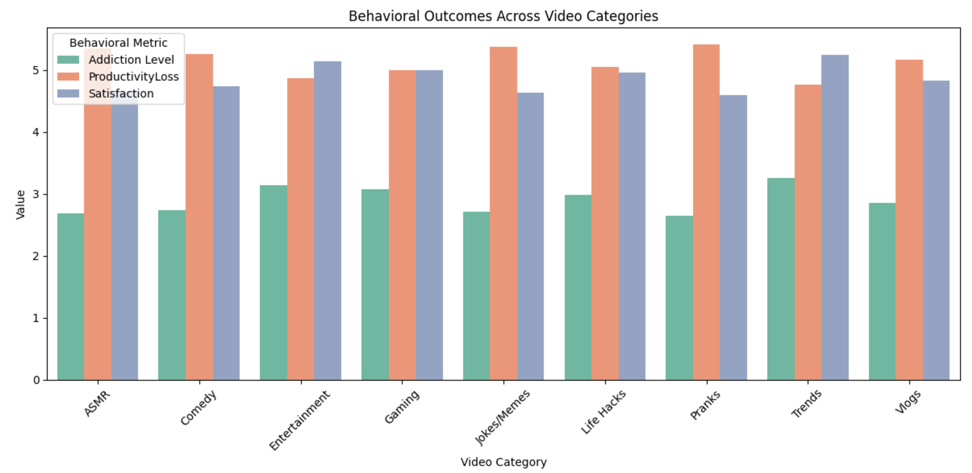
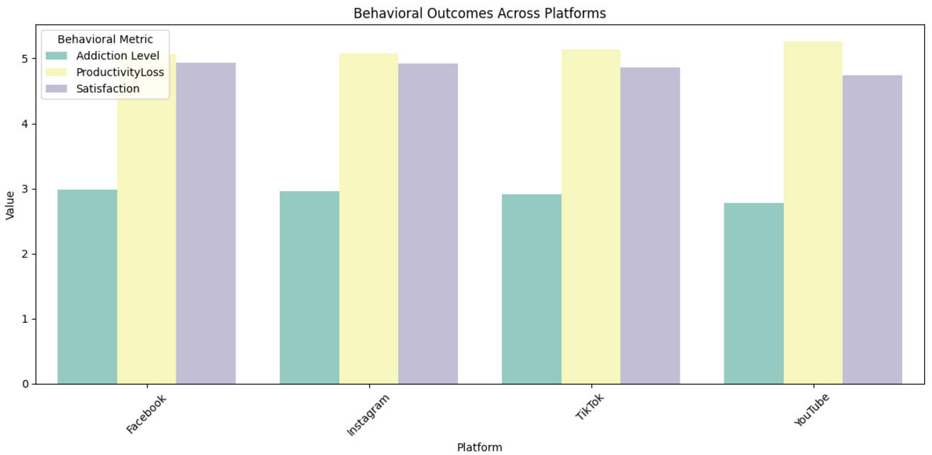
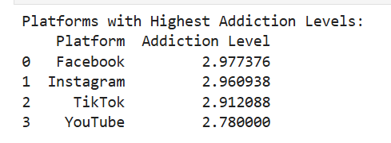
Analysis 2: Recommendation
Goal: Develop a comprehensive recommendation system to:
Identify video types and platforms influencing behavioral outcomes
Analyze addiction levels, productivity loss, and satisfaction across demographics.
Predict and mitigate adverse behavioral impacts.
Concept: Determine platforms (e.g., Facebook, TikTok) and video categories (e.g., Pranks, Trends) contributing to addiction and productivity loss. Group outcomes (addiction, productivity, satisfaction) by gender, age, and profession. Group users with similar engagement patterns to develop targeted interventions.
Approach:
Latent Feature Modeling (NMF) to identify hidden patterns
Clustering (K-means) to group users and detect high-risk behaviors
Cosine similarity to profile high-addictions users for targeted interventions
Notes:
Svetlana: Our goal was to develop a recommendation system that identifies video types and platforms influencing behavioral outcomes, such as addiction, productivity loss, and satisfaction, across demographics like age, gender, and profession. Using advanced techniques like latent feature modeling, clustering, and cosine similarity, we will uncover patterns, group high-risk users, and design targeted interventions to mitigate negative impacts.

Slide 14
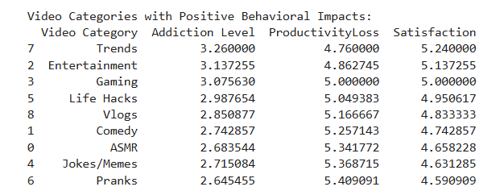
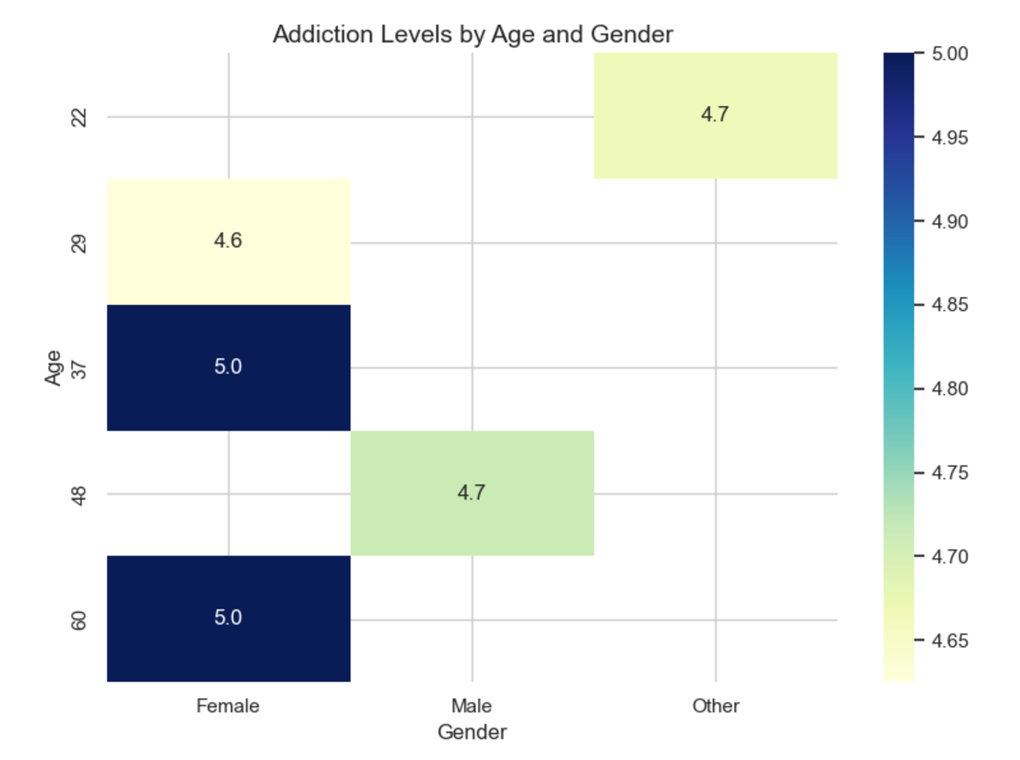
Recommendation Outcome:
Platform Insights:
Highest Addiction Levels: Facebook (2.98), Instagram (2.96), TikTok (2.91)
Lowest Addiction: YouTube (2.78) with longer-form content reducing compulsive engagement.
High Satisfaction: Facebook (4.93), Instagram (4.92), but associated with high addiction.
Video Categories:
Negative Impact: Pranks and Memes lead to high productivity loss (>5.3).
Positive Impact: Trends and Entertainment maximize satisfaction (>5.1).
Demographic Patterns:
High Addiction: Female teachers (35), middle-aged females (60), and younger males (22) exhibit the highest addiction levels.
Low Productivity Loss: Female students and labor workers maintain minimal disruption despite high engagement.
Notes:
Svetlana : Our analysis reveals that platforms like Facebook, Instagram, and TikTok show the highest addiction levels, while YouTube has the lowest due to its longer-form content. Video categories such as pranks and memes significantly reduce productivity, whereas trends and entertainment content improve user satisfaction. Demographically, high addiction levels are more common in female teachers, middle-aged women, and younger males, while female students and labor workers experience minimal productivity loss despite high engagement.

Slide 15
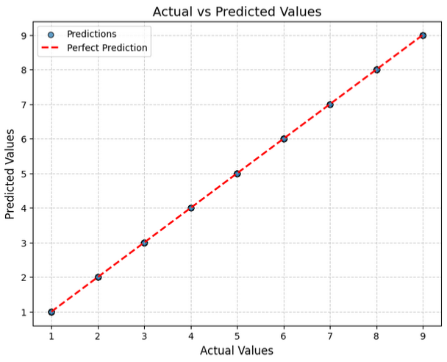
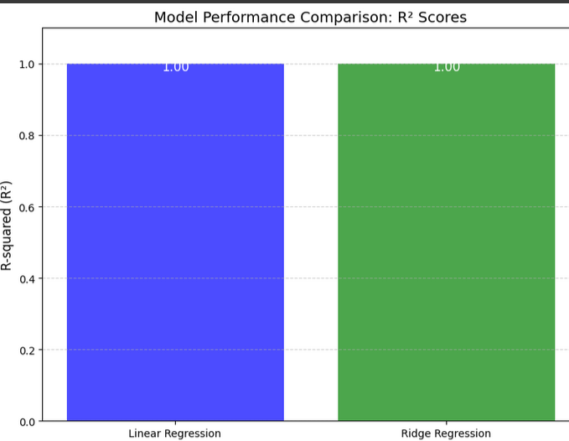
Analysis 3: Linear & Ridge Regression
Purpose: Predict addiction level using features like Age, Scroll Rate, Engagement, Productivity Loss, and Income. Ensure the model's predictions are reliable and work well on new data.
Linear Regression Outcome
Mean Squared Error (MSE): 0.00
R-squared (R²): 1.00
Perfect alignment between predicted and actual values
Ridge Regression Outcome
Mean Squared Error (MSE): 0.00
R-squared (R²): 1.00
Added regularization ensures stability and prevents overfitting.
Cross-Validation Results
R² Scores for 5 Folds: [1.00, 1.00, 1.00, 1.00, 1.00]
Mean R² Score: 1.00
Consistent performance across all folds
Graph 1 : Actual vs Predicted values
Graph 2 :Model Comparison
Notes:
Habeeb

Slide 16
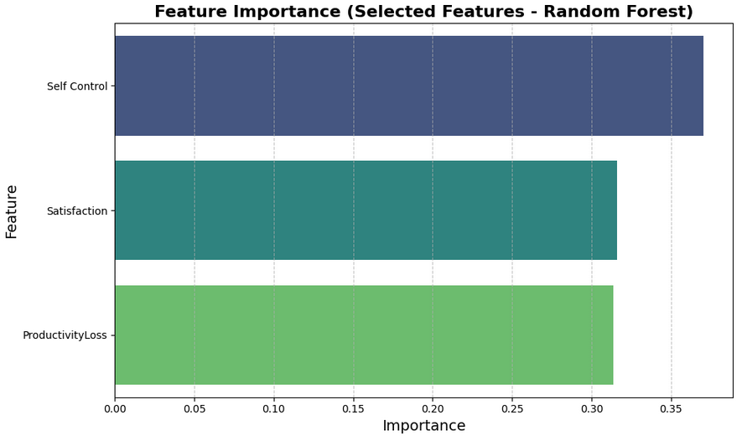
Analysis 3: Random Forest Regression
Purpose: Use non-linear relationships between features to predict addiction level.
Identify key predictors affecting mental health outcomes.
Random Forest Performance
Mean Squared Error (MSE): 0.00
R-squared (R²): 1.00
Model predicts the target variable perfectly
Feature Importance (Most Influential)
Satisfaction: 41.3%
Productivity Loss: 31.3%
Self Control: 27.4%
Bar Graph : Most influential features
Notes:
Habeeb

Slide 17
Analysis 4: Classification
Goal: Classify individuals based on addiction levels to provide actionable insights. These classifications can help identify individuals at different risk levels to support targeted interventions.
Approach:
Data Preprocessing:
Standardize/Normalize features and remove features that dominate predictions
Encode categorical variables
Model Tuning with Cross-Validation: Performed 3-fold cross-validation to fine-tune model parameters
Classification Models: Naive Bayes and Random Forest

Slide 18
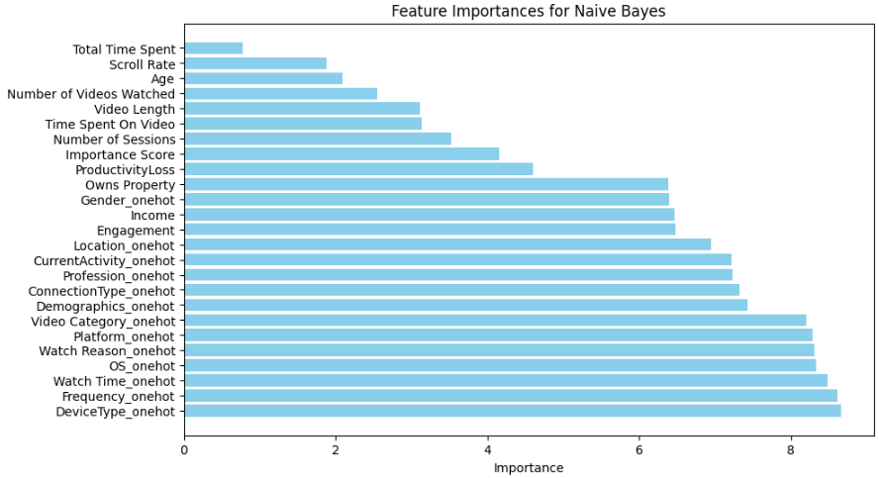
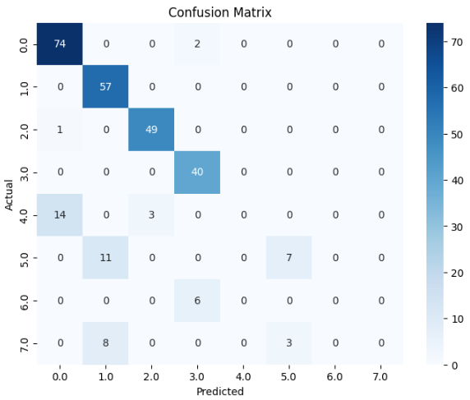
Naive Bayes Results
Purpose: Establish a simple, interpretable baseline for predicting
the target value – Addiction Level.
Performance Predicting the exact Target Value (0-7):
Accuracy: 52%
Precision: 53%
Recall: 52%
F1 Score: 52%
Performance Predicting Categorical Target Value (Low, Med, High):
Accuracy: 83%
Precision: 84%
Recall: 83%
F1 Score: 83%

Slide 19
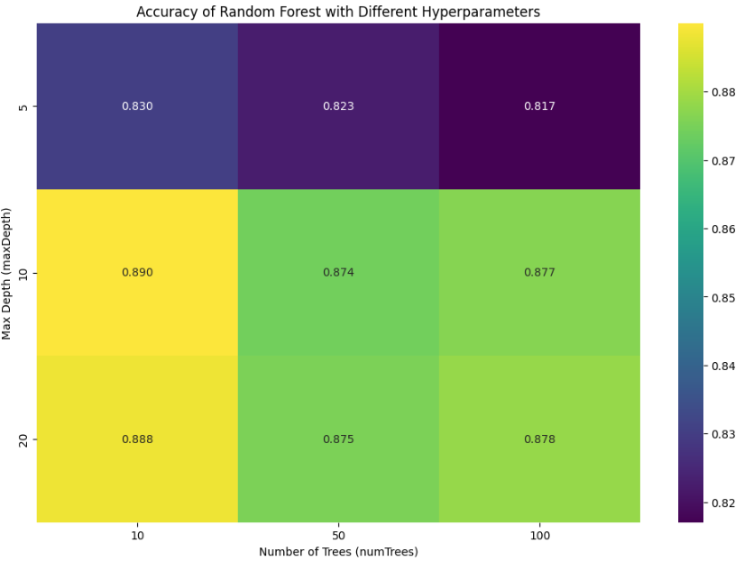
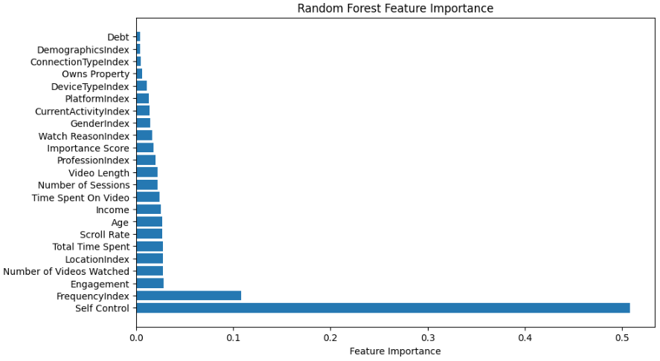
Random Forest Results
Purpose: Achieve robust and interpretable predictions for predicting both
numerical and categorical target values.
Performance Predicting the exact Target Value (0-7):
Accuracy: 79%
Precision: 72%
Recall: 79%
F1 Score: 77%
Performance Predicting Categorical Target Value (Low, Med, High):
Accuracy: 89%
Precision: 91%
Recall: 89%
F1 Score: 85%
Visual illustrating the Cross-Validation process
Initial feature importance – “Self Control” dominating predictions

Slide 20
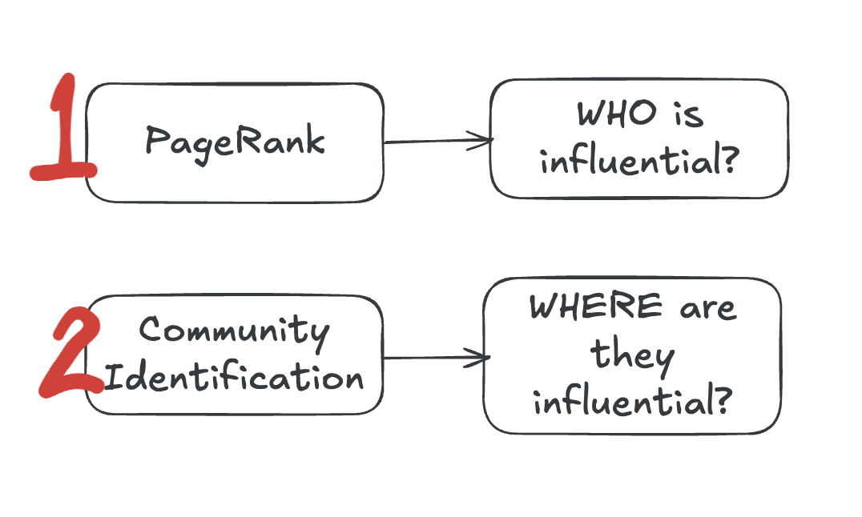
Analysis 5: Graph Network Analysis
Goal: Utilize Network Analysis to understand relationship between user influence and addiction patterns.
Approaches:
PageRank:
Network Analysis using PageRank for influence detection
WHO is influential?
Community-based Analysis with Louvain
Apply louvain method for community detection on a network graph G to partition 1000 users into communities based on their social media behavior patterns.
WHERE are they influential?
https://colab.research.google.com/drive/1h607JTqx3tXG5m8ugppQsrfmX0CQoz4F#scrollTo=NW1JsC617DbK

Slide 21
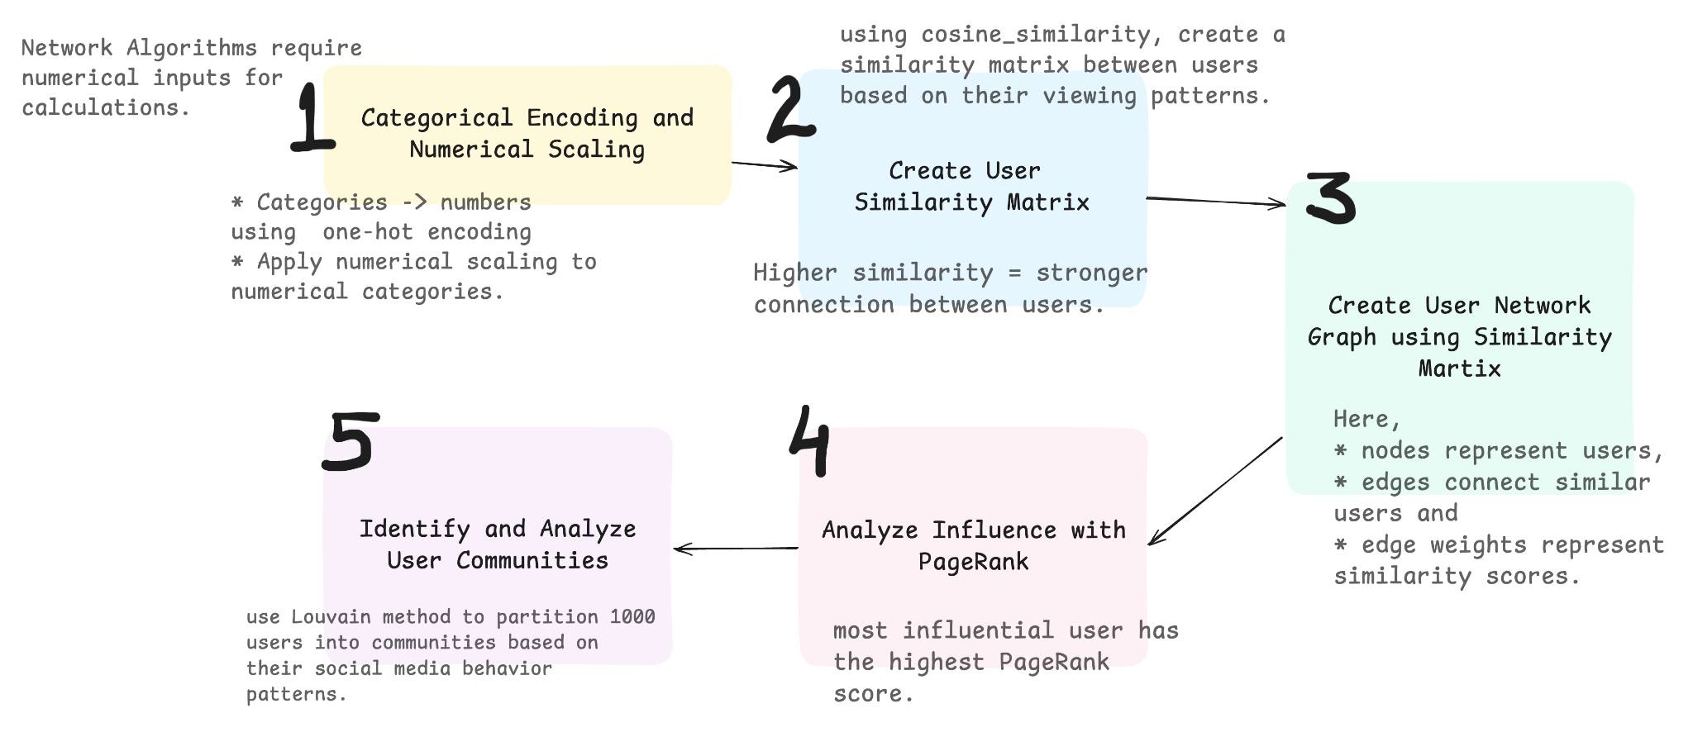
Network Analysis Implementation

Slide 22
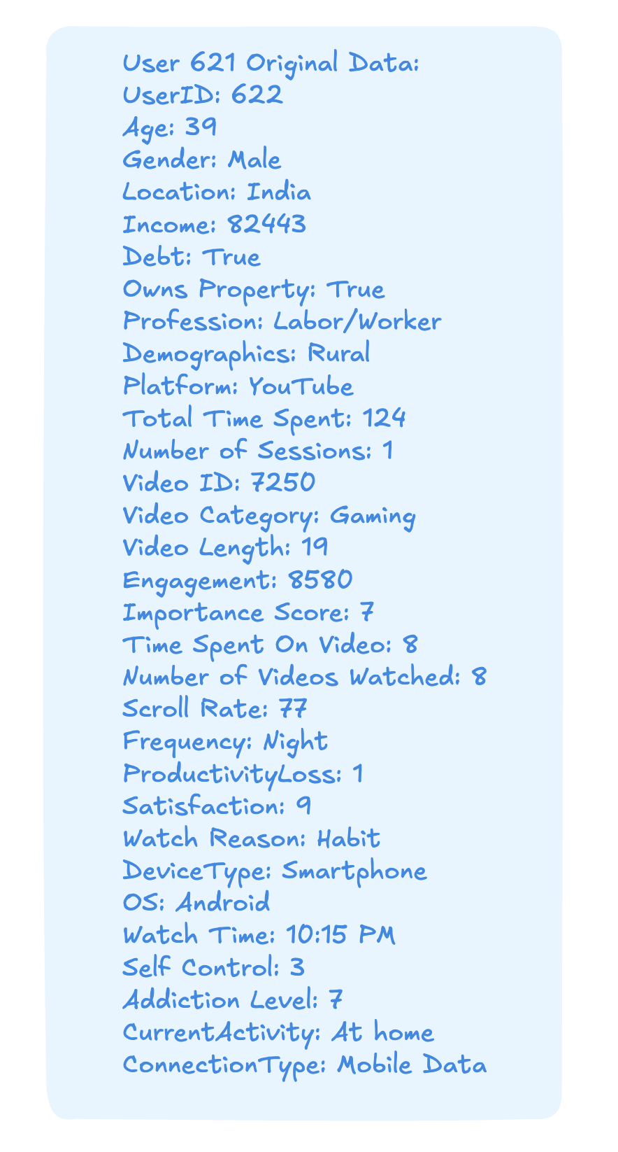
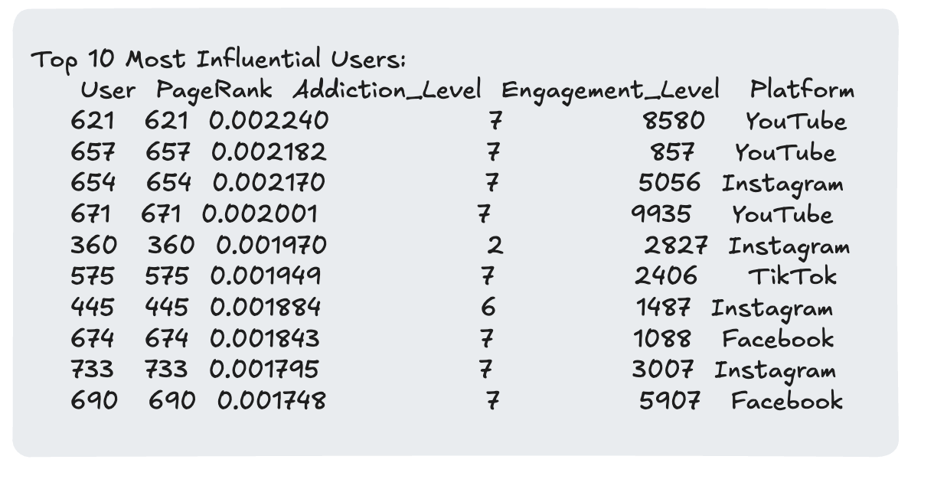
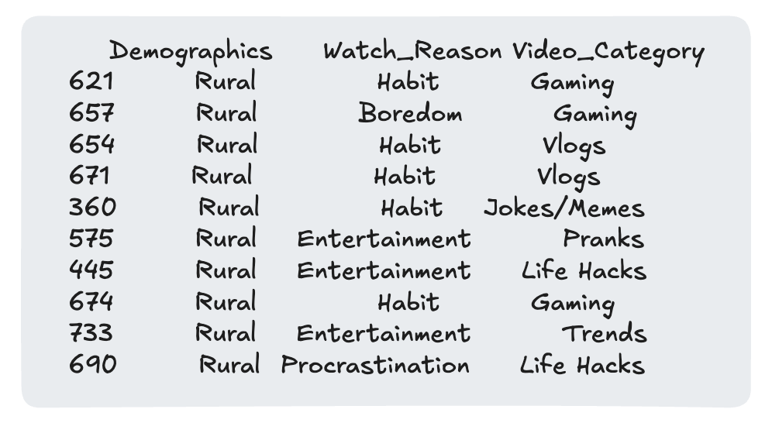
PageRank Analysis - WHO is Influential?
Key Findings
8/10 most influential users have highest addiction levels
Platform distribution:
YouTube and Instagram dominate
All from rural demographics
Most influential user profile:
High engagement (8580)
Gaming content
Watch reason: Habitual
Rural demographic

Slide 23
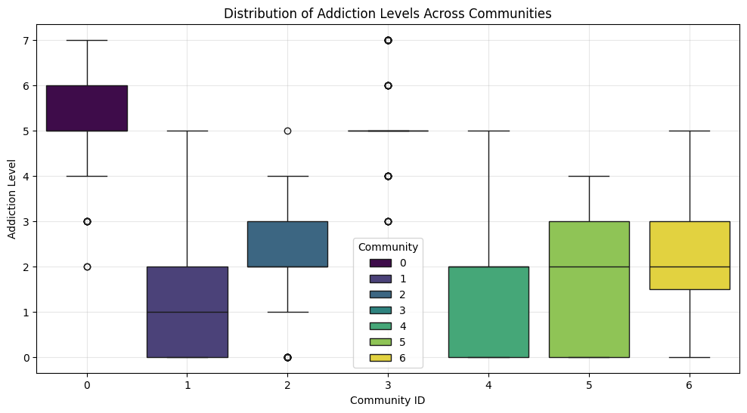
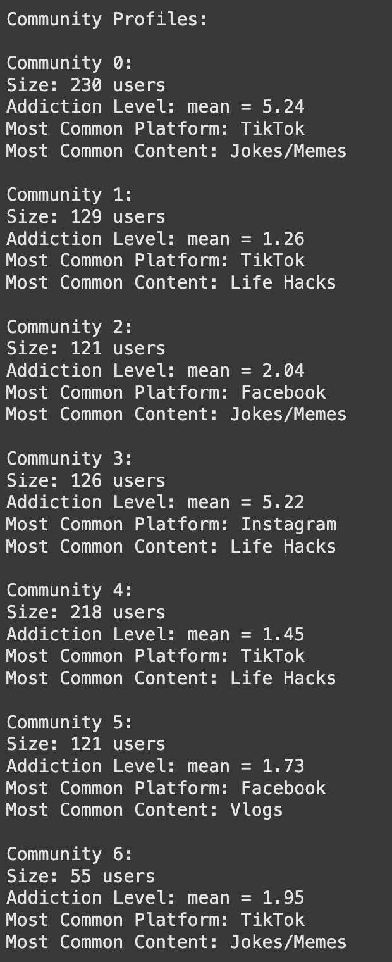
Community Analysis - WHERE are they Influential?
Key Findings
7 distinct communities identified
Size: Ranges from 55 to 230 users
Addiction Patterns:
High-addiction communities (0 & 3): mean ~5.2
Low-addiction communities (1,4,5,6): mean ~1.5
Platform Distribution:
TikTok primarily present
Instagram seen in a high-addiction community (3)
Popular content: Jokes/Memes and Life Hacks

Slide 24
Key Takeaways: Graph Network Analysis
Risk Factors:
Rural users with high engagement
Gaming and Jokes/Memes content
Youtube, Tik Tok and Instagram and
Habitual platform usage
Intervention Opportunities:
Target influential users for awareness
Focus on Communities 0 & 3
Promote balanced content consumption
Platform-specific strategies needed.

Slide 25
Key Takeaways
EDA: Guided analysis by uncovering critical insights, such as weak correlations and synthetic data artifacts, refining feature selection and hypotheses.
Clustering:
Clustering revealed at-risk groups and demographic patterns.
LSH enabled scalable, real-time grouping of similar users.
Recommendation Systems: Used latent feature modeling to identify addiction drivers, guiding content adjustments to reduce harmful engagement.
Regression & Tree-Based Methods: Quantified key addiction factors and modeled relationships of various factors with addiction levels.
Network Analysis:
PageRank identified influential users spreading addictive behaviors.
Network clustering revealed behavioral patterns in user communities.
Classification: Random Forest models captured complex, non-linear patterns to enhance risk classification accuracy.
Technical Proficiency: Leveraged Spark and PySpark for scalable data processing and applied advanced machine learning techniques to analyze large datasets.
Outcome: Developed a comprehensive, data-driven approach to understand and address social media addiction.
Notes:
Megha

Slide 26
Thank You
Notes:
Megha

Slide 27
Sources
Intro statistic: https://www.lanierlawfirm.com/social-media-addiction/statistics/

